Slide 1
Introduction to Parallel Computing
Byoung-Do (BD) Kim, PhD
Associate Chief Research Information Officer
Director, Center for Advanced Research Computing

Slide 2
Outline
Introduction
Theoretical background
Types of parallel computing systems
Programming models
Examples
Hands-on session

Slide 3
Why Parallel Computing?
Limits of single CPU computing
performance
available memory
Parallel computing allows one to:
solve problems that don’t fit on a single CPU
solve problems that can’t be solved in a reasonable time
We can solve…
larger problems
faster
more cases

Slide 4
What is Parallel Computing?
Parallel computing: use of multiple processors or computers working together on a common task.
Each processor works on its section of the problem
Processors can exchange information
Grid of Problem to be solved
CPU #1 works on this area
of the problem
CPU #2 works on this area
of the problem
information
exchange
y
information
exchange
information
exchange
CPU #3 works on this area
of the problem
CPU #4 works on this area
of the problem
information
exchange
x

Slide 5




Supercomputing Applications
Black Hole Simulation
Nature article
Black Hole simulation
Formular 1 Racing Car Aerodynamics:
F1 aerodynamics
Winner of Baku Grand Prix, Flex wing debate
Supercomputing vs. COVID-19
Modeling COVID19 spread-out
Drug discovery for COVID-19 using supercomputer
AI & Supercomputer
DeepMind AlphaGo defeated professional Go player 4:1
AlphaGo Movie
Stock Market High-Frequency Trading

Slide 6
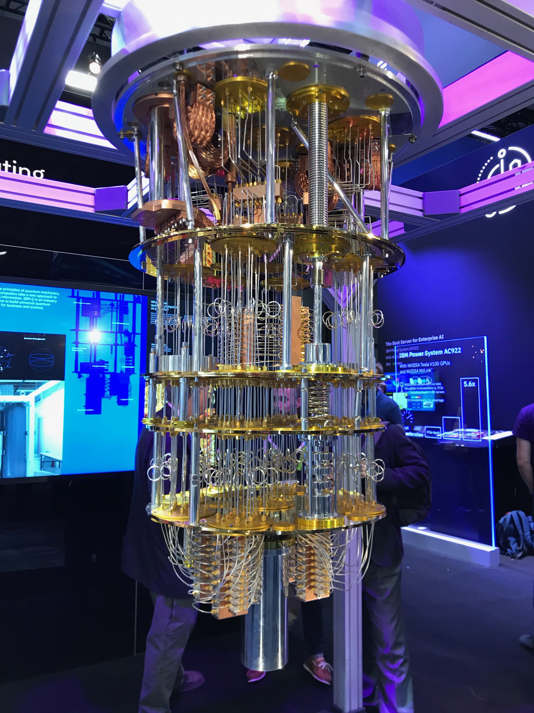
Top 500

Slide 7
Limits of Parallel Computing
Theoretical Upper Limits
Amdahl’s Law
Practical Limits
Load balancing
Non-computational sections
Communication overhead
Other Considerations
time to re-write code

Slide 8
Theoretical Upper Limit to Performance
All parallel programs contain:
parallel sections (we hope!)
serial sections (unfortunately)
Serial sections limit the parallel effectiveness
Amdahl’s Law states this formally

Slide 9
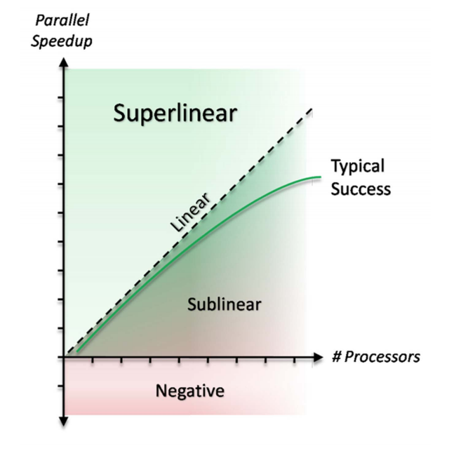
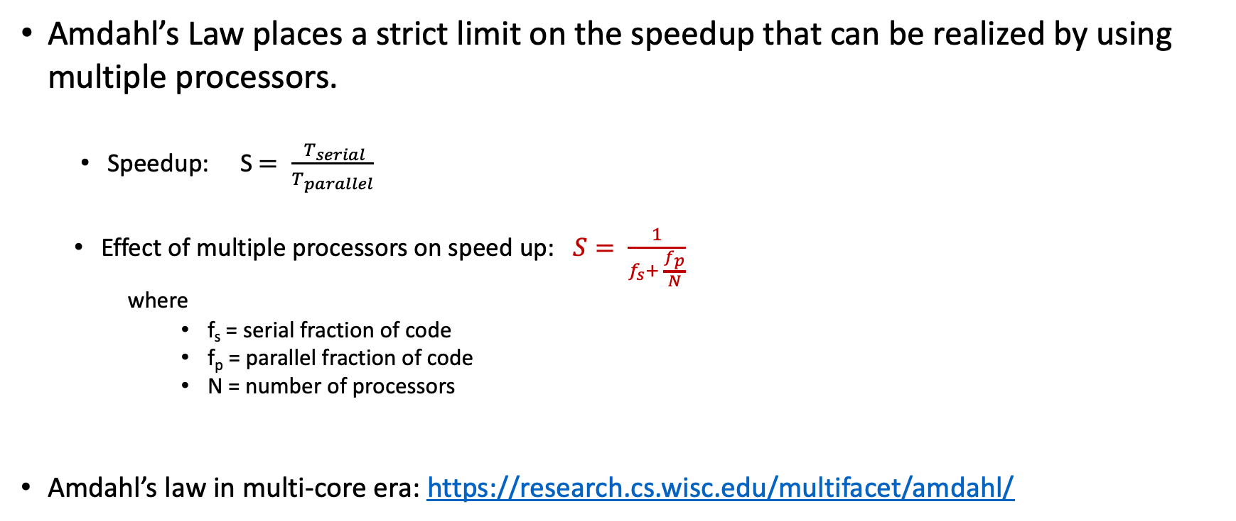
Amdahl’s Law
Amdahl’s Law places a strict limit on the speedup that can be realized by using multiple processors.
Speedup: S $= \frac{ T_{serial}}{T_{parallel}}$
Effect of multiple processors on speed up: $S= \frac{1}{f_{s}+ \frac{f_{p}}{N}}$
where
f_{s} = serial fraction of code
f_{p} = parallel fraction of code
N = number of processors
Amdahl’s law in multi-core era: https://research.cs.wisc.edu/multifacet/amdahl/
Notes:
Case: f_{s} = 0, f_{p} = 1, then S = N (perfect parallelization)
N goes to infinity: S = 1/f_{s}, so if 10% of the code is sequential,
you will never speed up by more than 10, no matter the number of processors.

Slide 10
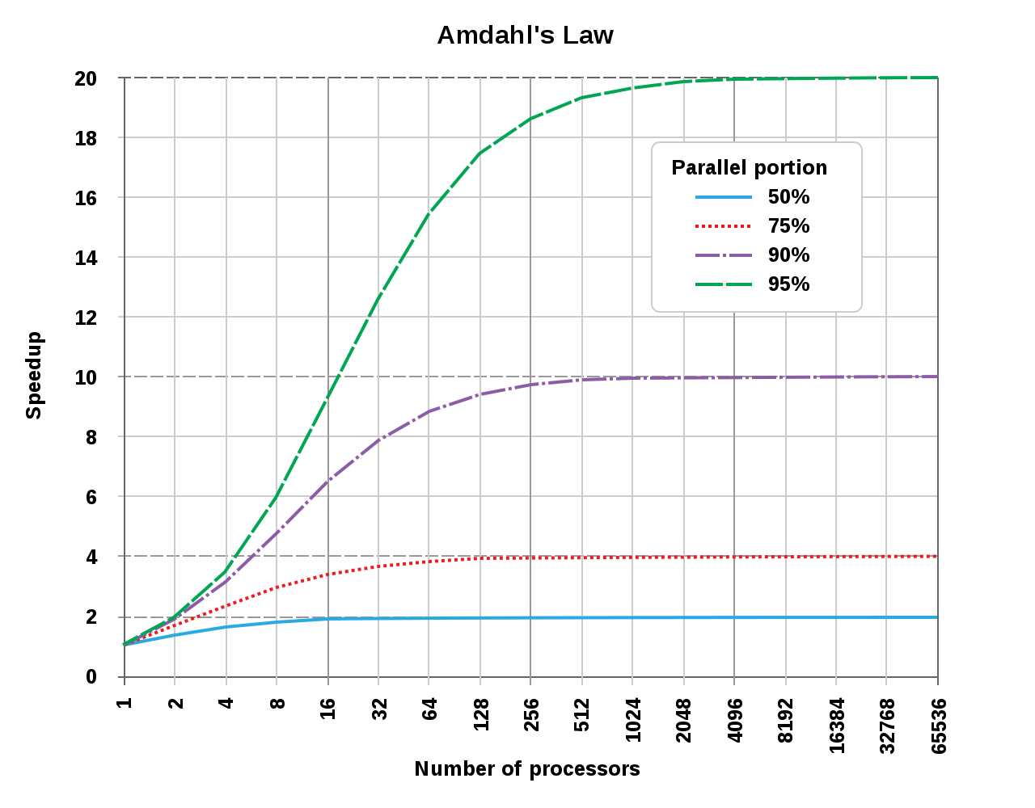
Illustration of Amdahl’s Law
It takes only a small fraction of serial content in a code to degrade the parallel performance.
From Wikipedia: Amdahl’s Law
https://en.wikipedia.org/wiki/Amdahl%27s_law

Slide 11
Practical Limit: Amdahl’s Law vs. Reality
Amdahl’s Law provides a theoretical upper limit on parallel speedup assuming that there are no costs for communications. In reality, communications will result in a further degradation of performance.
80
f_{p} = 0.99
70
60
50
40
Amdahl's Law
Reality
30
20
10
0
0
50
100
150
200
250
Number of processors

Slide 12
Practical Limit: Amdahl’s Law vs. Reality
In reality, the situation is even worse than predicted by Amdahl’s Law due to:
Load balancing (waiting)
Scheduling (shared processors or memory)
Communications
I/O

Slide 13
Other Considerations
In reality, the situation is even worse than predicted by Amdahl’s Law
Scheduling (shared processors or memory)
Communications
I/O
Writing effective parallel applications is difficult!
Load balance is important
Communication can limit parallel efficiency
Serial time can dominate
Is it worth your time to rewrite your application?
Do the CPU requirements justify parallelization?
Will the code be used just once?

Slide 14
Parallel Computing Models
Parallel System Architecture
Parallel Programming Models
MPI Programming Basics

Slide 15
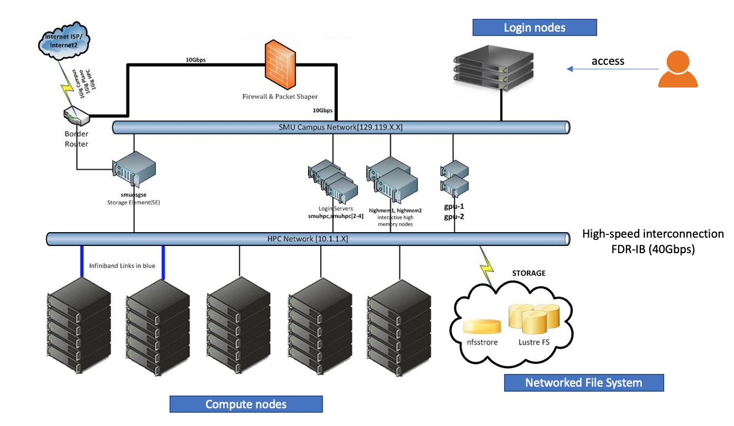
HPC in a Nutshell: Cluster System Architecture

Slide 16


HPC in a Nutshell: SW Stack
Users’ Codes
SW Stack
User Interface, IDE’s
Applications
User-facing
SW stack
Compilers, MPI Stack, Math Libs, etc.
System OS, File System, Provisioning, Config Mgmt
System
Administration
Cluster, Storage, Network
Infrastructure

Slide 17
Shared vs. Distributed Memory
M
M
M
M
M
Memory
P
P
P
P
P
P
P
P
P
P
Network
Shared memory:
Single address space.
All processors have access to a pool of shared memory.
Methods of memory access :
Bus, Crossbar
Programming model: OpenMP
Distributed memory:
Each processor has its own local memory.
Must do message passing to exchange data between processors.
Methods of memory access :
Various topological interconnection
Programming model: MPI

Slide 18
Multicore with Accelerators
Memory
Memory
Memory
Memory
GPU
GPU
GPU
GPU
Network
A limited number of processors N have access to a common pool of shared memory
To use more than N processors requires data exchange over a network
Communication details increasingly complex
Cache access
Main memory access
Quick Path / Hyper Transport socket connections
Node to node connection via network
Load balancing critical for performance
Requires specific libraries and compilers (CUDA, OpenCL, ACC, etc.)

Slide 19
Parallel Programming Models
Data Parallelism
Each processor performs the same task on different data
Task Parallelism
Each processor performs a different task on the same data (or on different data)
Most applications fall between these two

Slide 20
Data Parallel Programming Example
One code will run on 2 CPUs
Program has array of data to be operated on 2 CPUs, array is split into two parts.
program:
…
if CPU=a then
low_limit=1
upper_limit=50
elseif CPU=b then
low_limit=51
upper_limit=100
end if
do I = low_limit, upper_limit
work on A(I)
end do
...
end program
CPU A
CPU B
program:
…
low_limit=1
upper_limit=50
do I= low_limit, upper_limit
work on A(I)
end do
…
end program
program:
…
low_limit=51
upper_limit=100
do I= low_limit, upper_limit
work on A(I)
end do
…
end program

Slide 21
Task Parallel Programming Example
One code will run on 2 CPUs
Program has 2 tasks (a and b) to be done by 2 CPUs
program.c:
…
initialize
...
if CPU=a then
do task a
elseif CPU=b then
do task b
end if
….
end program
CPU A
CPU B
program.c:
…
initialize
…
do task a
…
end program
program.c:
…
initialize
…
do task b
…
end program

Slide 22
Single Program Multiple Data
SPMD: dominant programming model for shared and distributed memory machines.
One source code is written
Code can have conditional execution based on which processor is executing the copy
All copies of code start simultaneously and communicate and sync with each other periodically
MPMD: more general, and possible in hardware, but no system/programming software enables it

Slide 23
SPMD Model
source.c
source.c
source.c
source.c
source.c
processor 0
processor 1
processor 2
processor 3
Network
Ideal programming model in multi-node system environment

Slide 24
Data Decomposition
For distributed memory systems, the ‘whole’ grid or sum of particles is decomposed to the individual processors
Each CPU works on its section of the problem
CPUs/Nodes can exchange information
Grid of Problem to be solved
CPU #1 works on this area
of the problem
CPU #2 works on this area
of the problem
information
exchange
y
information
exchange
information
exchange
CPU #3 works on this area
of the problem
CPU #4 works on this area
of the problem
information
exchange

Slide 25
Domain Decomposition Example
Integrated 2-D wave propagation problem
Starting partial
differential equation:
Finite Difference
Approximation:
Proc
#0
Proc
#1
Proc
#2
Proc
#3
y
Proc
#4
Proc
#5
Proc
#6
Proc
#7
x

Slide 26
Information Propagation between Processes
Proc
#0
Proc
#1
Proc
#2
Proc
#3
How do we decide on what & how much of information should be passed along between decomposed computational domain?
- based on PDE’s characteristics
y
Proc
#4
Proc
#5
Proc
#6
Proc
#7
x
Elliptic PDE
Parabolic PDE
Hyperbolic PDE
Range of
influence
t
t
Physical boundary
t
Range of
influence
Physical boundary
p
p
Domain of
dependence
Domain of
dependence
* Information
propagation speed:
x
x
x
Undefined
Infinite
Finite

Slide 27
MPI: Message Passing Interface
MPI 1 was released in 1994, MPI 2.0 in 1997, and MPI 3.0 in 2012
Distributed memory programming
Ideal for multi-node parallelization
Can use with OpenMP for better scalability
Distributed memory systems have separate address spaces for each processor
Local memory accessed faster than remote memory
Data must be manually decomposed
MPI is the standard for distributed memory programming

Slide 28
MPI Programming: Basic Structure
Every MPI program needs these:
#include <mpi.h> /* the mpi include file */
int main(int argc, char *argv[])
{
/* Initialize MPI */
ierr = MPI_Init(&argc, &argv);
/* How many total PEs are there */
ierr = MPI_Comm_size(MPI_COMM_WORLD, &nPEs);
/* What node am I (what is my rank? */
ierr = MPI_Comm_rank(MPI_COMM_WORLD, &iam);
...
ierr = MPI_Finalize();

Slide 29
MPI Example
#include #include "mpi.h” int main(int argc, char *argv[]) int argc; char *argv[]; { int myid, numprocs; MPI_Init(&argc,&argv); MPI_Comm_size(MPI_COMM_WORLD,&numprocs); MPI_Comm_rank(MPI_COMM_WORLD,&myid); /* print out my rank and this run's PE size*/ printf("Hello from %d\n",myid," of ",numprocs); MPI_Finalize(); }

Slide 30
Message Passing Communication
A
B
Processes in message passing program communicate by passing messages
Basic message passing primitives
MPI_Send (parameters list)
MPI_Receive (parameter list)
These calls are blocking: the source processor issuing the send/receive cannot move to the next statement until the target processor issues the matching receive/send.

Slide 31
MPI Example: Send & Receive
#include "mpi.h”
/************************************************************
This is a simple send/receive program in MPI
************************************************************/
int main(int argc,char *argv[])
{
int myid, numprocs, tag,source,destination,count,buffer ;
MPI_Status status;
MPI_Init(&argc,&argv);
MPI_Comm_size(MPI_COMM_WORLD,&numprocs);
MPI_Comm_rank(MPI_COMM_WORLD,&myid);
tag=1234;
source=0;
destination=1;
count=1;
if(myid == source){
buffer=5678;
MPI_Send(&buffer,count,MPI_INT,destination,tag,MPI_COMM_WORLD);
printf("processor %d sent %d\n",myid,buffer);
}
if(myid == destination){
MPI_Recv(&buffer,count,MPI_INT,source,tag,MPI_COMM_WORLD,&status);
printf("processor %d got %d\n",myid,buffer);
}
MPI_Finalize();
}

Slide 32
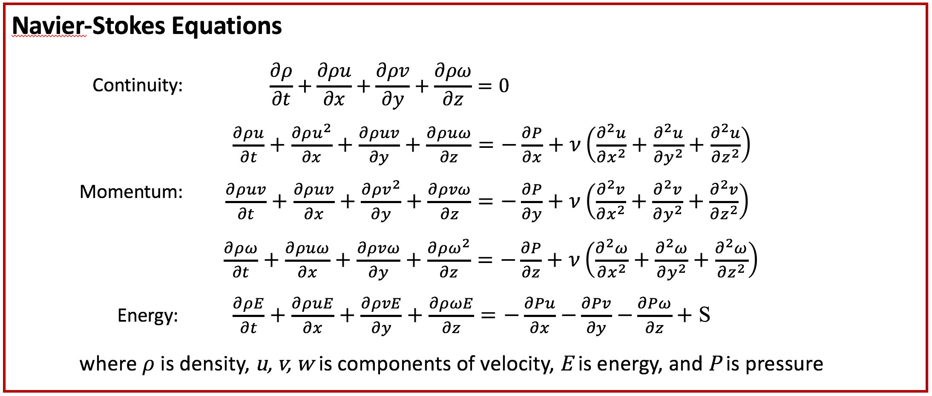
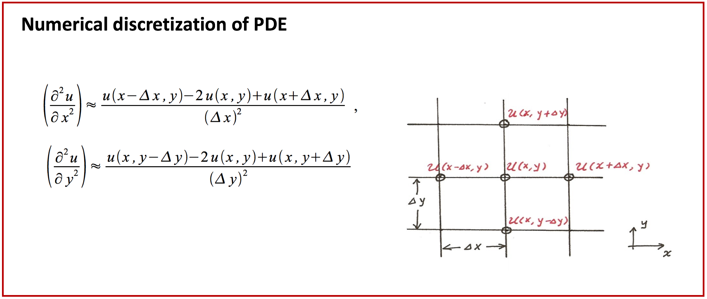
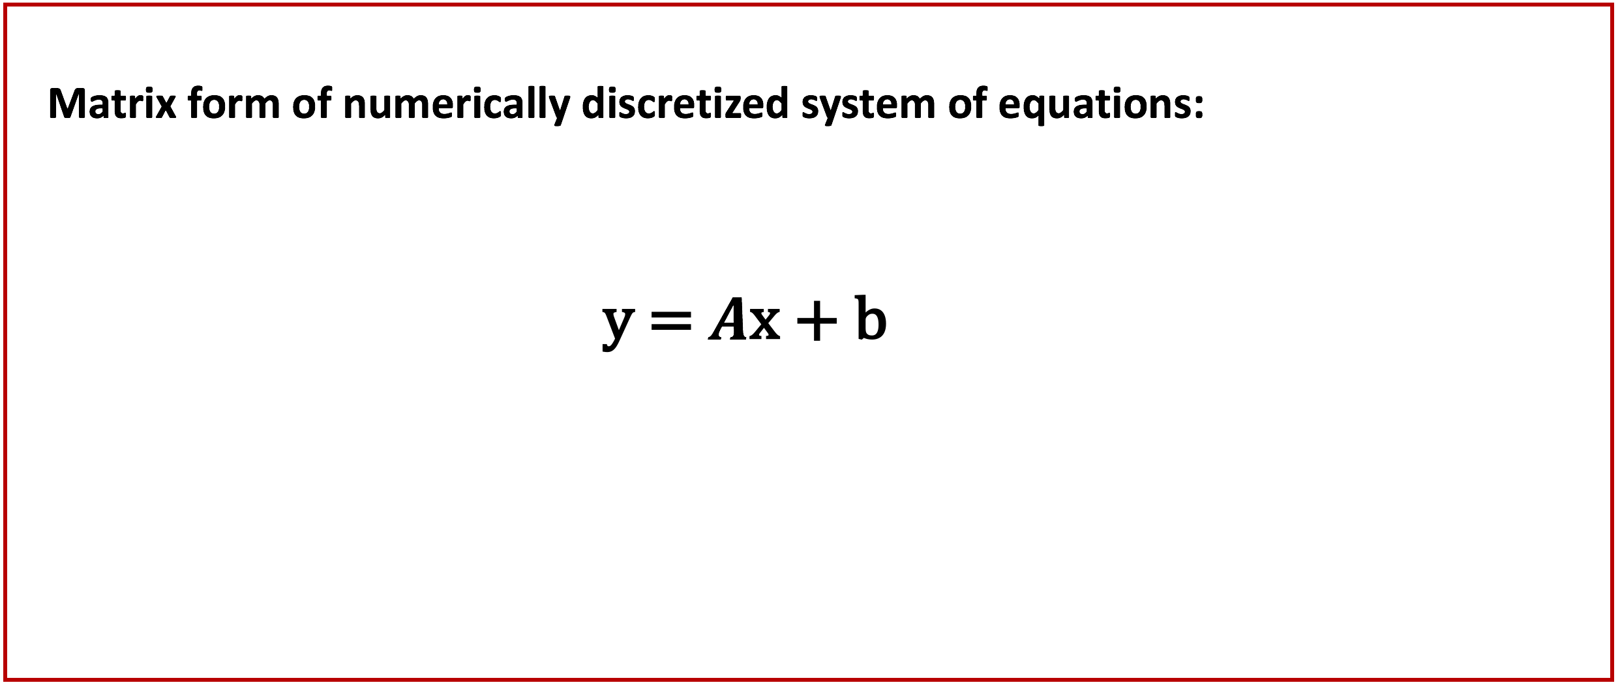
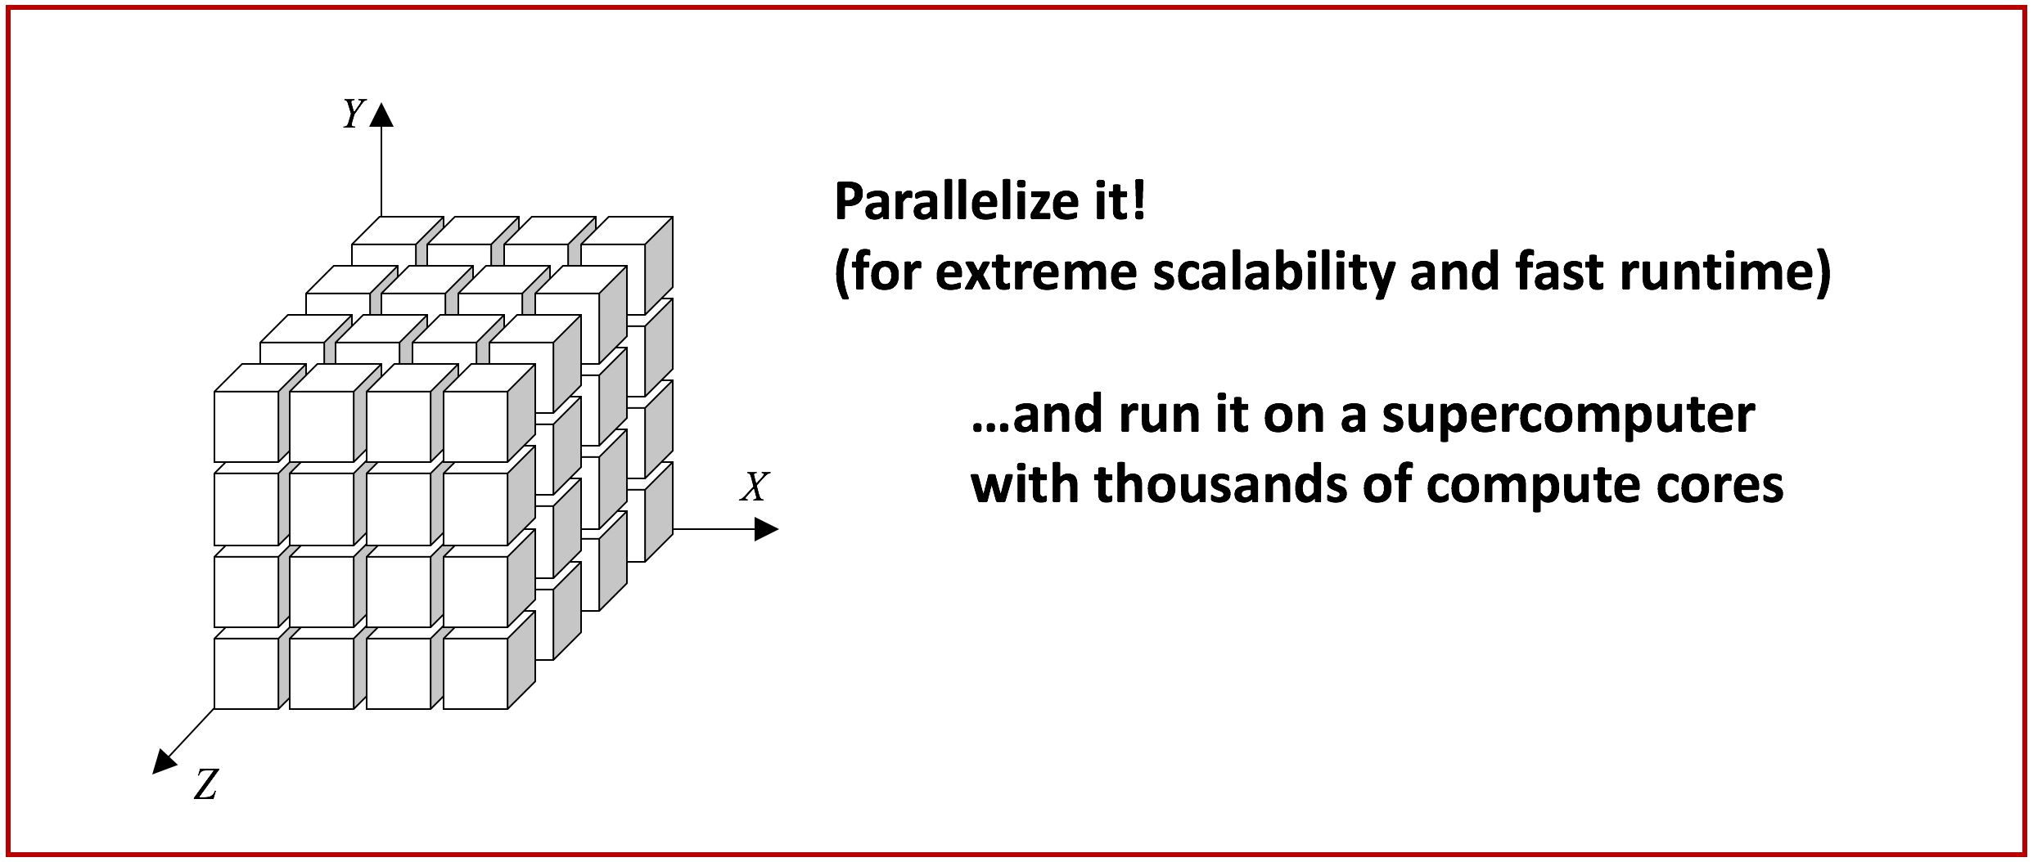
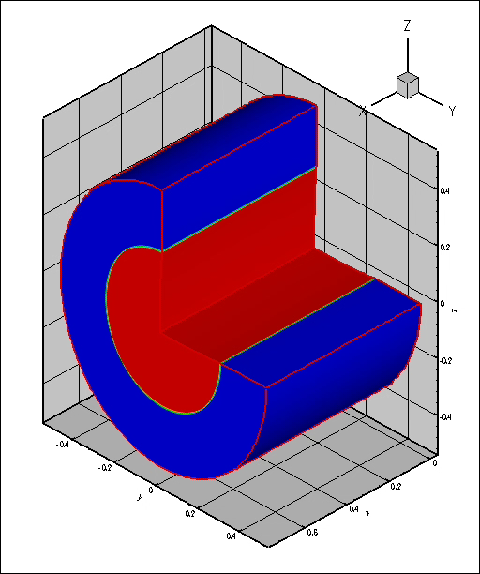
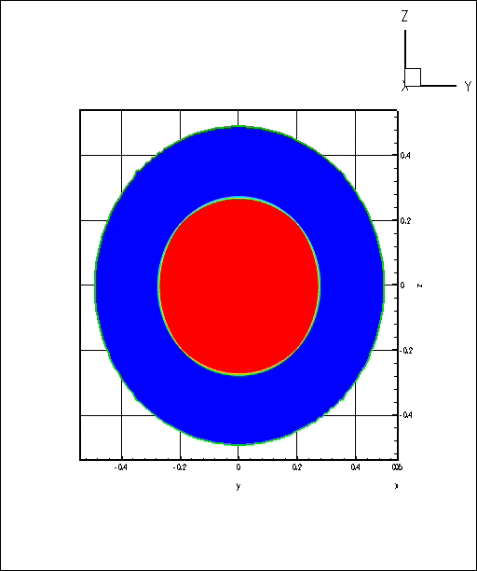
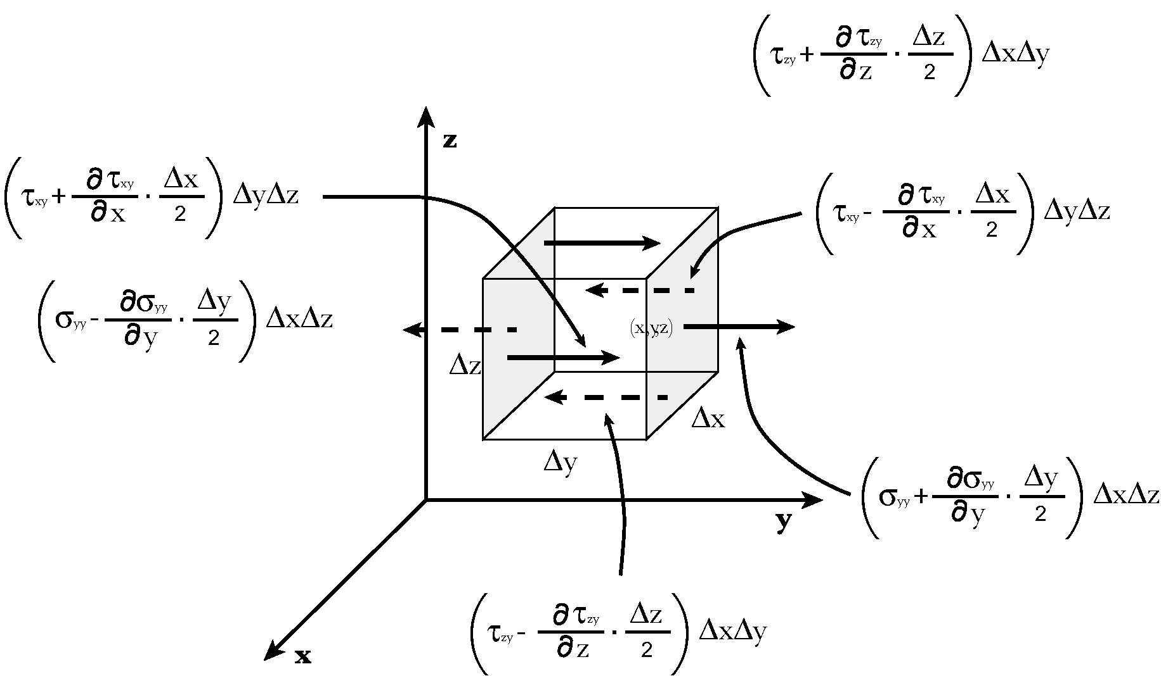
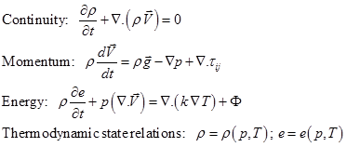
Quick Overview of Parallel Computing
Simulation-focused, solving grand-challenging problems
Systems of equations with well-defined boundary conditions
e.g. Computational Fluid Dynamics (CFD)
Closed systems of equations, controllable conditions
Mathematically proven methods, numerically discretized
Well-suited for heavy computation

Slide 33
Hands-on session w/ examples
Hello World
Pi-calculation
MPICH vs OpenMPI – different MPI stack
Compilers – Intel vs gcc
MKL vs OPENBLAS/LAPACK/SCALAPACK

